Slide 1
Intradermal injection of autologous platelet-rich plasma for the treatment of vulvar lichen sclerosus
Andrew T. Goldstein, MD, Michelle King, MSc, Charles Runels, MD, Meghan Gloth, MD, Richard Pfau, MD
Journal of the American Academy of Dermatology
Volume 76, Issue 1, Pages 158-160 (January 2017)
DOI: 10.1016/j.jaad.2016.07.037
Copyright © 2016 American Academy of Dermatology, Inc. Terms and Conditions

Slide 2
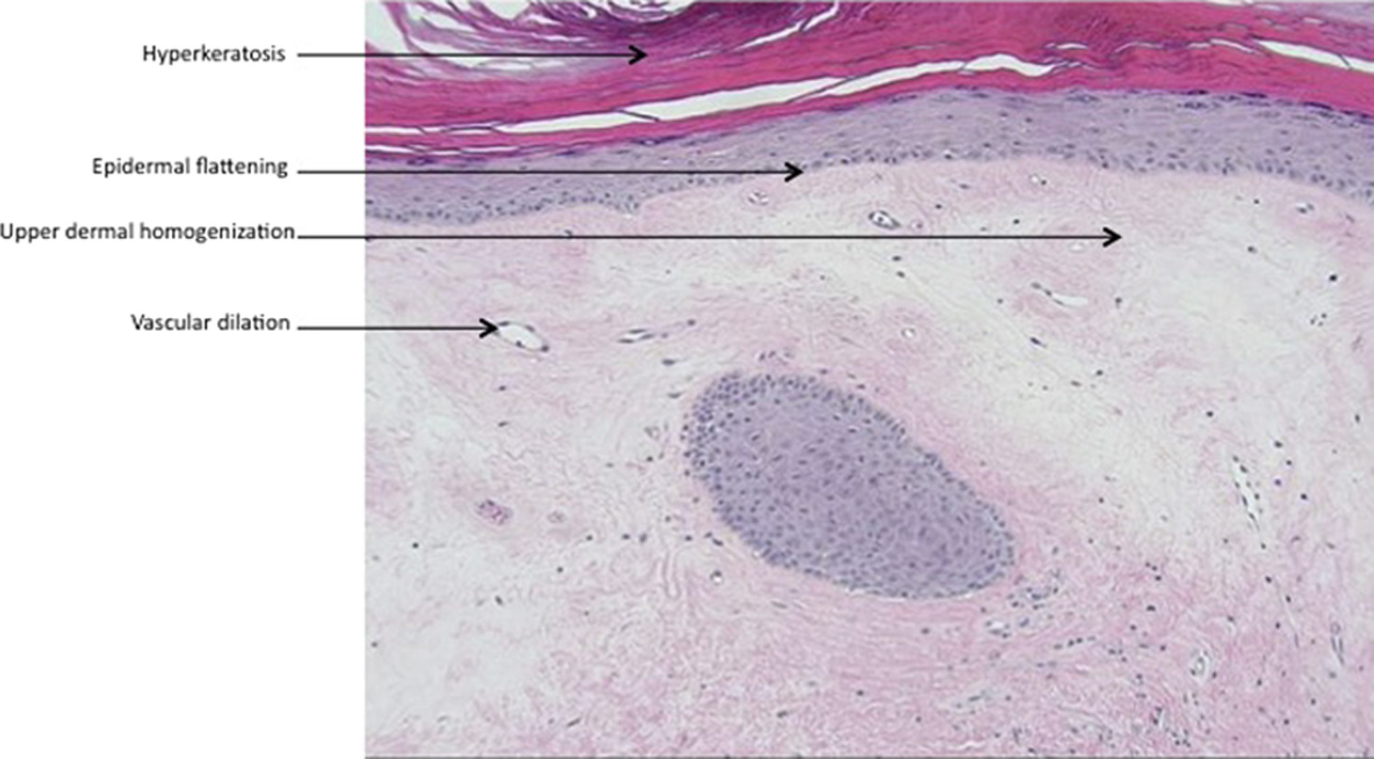
Journal of the American Academy of Dermatology 2017 76, 158-160DOI: (10.1016/j.jaad.2016.07.037)
Copyright © 2016 American Academy of Dermatology, Inc. Terms and Conditions
Notes:
Pretreatment biopsy demonstrates hyperkeratosis with flattening of the epidermis, homogenization of the upper dermis with vascular dilation, and focal inflammation in the mid-dermis. (Hematoxylin-eosin stain; original magnification ×100.)

Slide 3
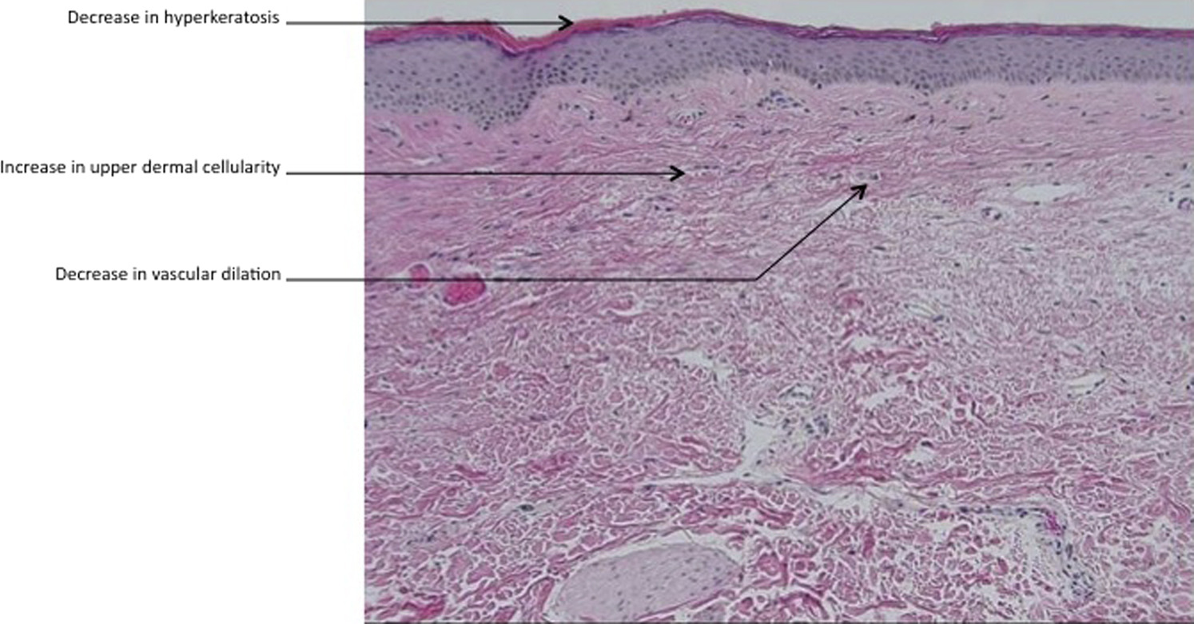
Journal of the American Academy of Dermatology 2017 76, 158-160DOI: (10.1016/j.jaad.2016.07.037)
Copyright © 2016 American Academy of Dermatology, Inc. Terms and Conditions
Notes:
Post-treatment biopsy shows a marked decrease in hyperkeratosis and a decrease in vascular dilation and inflammation, as well as a return of upper dermal cellularity. (Hematoxylin-eosin stain; original magnification ×100.)

